Slide 1
NuLog
Like all magnificent things, it's very simple

Slide 2
Log Events and Log Targets
Simplicity is the ultimate sophistication

Slide 3
What is NuLog?
NuLog is a:
Simple
Effective
Light-weight
Extensible
Tag-based logging framework
(No, it won’t make your coffee for you)

Slide 4
The Basics
Log Events
Logging consists of two simple elements: log events and log targets:
For example: a family’s signature on a guest role at a wedding
In software, logging is primarily used for troubleshooting, debugging and auditing purposes
A logging framework is responsible for providing a structured way to get log events into log targets
Log Targets

Slide 5
Log Events
Log Events
Log events are messages or objects to be delivered to a log target
Log events contain information about an event that is to be displayed to a user, or saved to a destination
A log event can be a simple message like “Hello, World!” or a complex multi-level object that represents a HTTP POST request
Log Targets

Slide 6
Log Targets
Log Events
Log targets receive log events
A log target can display a log event immediately, such as in a terminal window, or store the log event to persistent storage, such as in a file or database
Log targets can also interface web services or email clients, delivering the log event to a third party destination
A single log target is generally responsible for a single destination; For example, a single “File Target” would write to a single file
Log Targets

Slide 7
Tag-Based Logging
Simplicity is the ultimate sophistication

Slide 8
Tag-Based Logging
Tags
There can be multiple log targets in a software system, and therefore: we need a way to define which log events go to which log targets. NuLog uses a tag-based approach:
Tags are assigned to log events
Rules determine which log targets specific log events are dispatched to using the assigned tags, not all log events are dispatched to all log targets
Targets are responsible for handling the log events dispatched to them
Rules
Targets

Slide 9
Tags
Tags
Tags can represent practically anything pertaining to a log event:
A particular target, such as “database” or “file”
A particular status or event, such as “exception” or “authenticated”
A particular source of log events/messages, such as ¹ : SomeMVCApp.SomeController
Any other helpful grouping!
Rules
1. NuLog automatically includes the full class name of the calling object as a tag on the log event.
Targets

Slide 10
Targets
Tags
A single target represents a single destination for log events
A target can represent:
A rolling text file
A database table
A web service for logging
A console application
A Trace Log
Any other custom log event destination
Rules
Targets

Slide 11
Rules
Tags
Rules define which targets a log event is dispatched to using the assigned tags
Rules can be defined with:
Which tags to include in the rule
Which tags to exclude in the rule (specifically from those selected by “include”)
Whether or not all tags defined as “include” must be matched by the log event to match the rule
Which targets matching log events are to be dispatched to
Whether or not to process any further rules for the log event if the current rule matches
Rules
Targets

Slide 12
Basic Architecture
Coming together is a beginning; keeping together is progress; working together is success

Slide 13
Modular Architecture
Factory
The framework is divided into four major parts:
A factory for building the components of the framework
Loggers for sending log events to the dispatcher
A Dispatcher for dispatching log events to the log targets based on the configuration
Targets to receive and handle dispatched log events
Logger
Dispatcher
Targets

Slide 14
Factory
Factory
The Factory:
Reads/receives, builds, manages and distributes the configuration
Builds the dispatcher and targets using the configuration¹
Builds and provides loggers to the implementing application
Shuts down dispatcher and targets when the application is finished
Logger
Dispatcher
Targets
1. The factory leverages the Singleton Pattern to help keep resource usage low

Slide 15
Logger
Factory
A logger:
Is responsible for building and sending log events to the dispatcher
Provides “helper methods” for automatically assigning tags to log events
Provides “helper methods” for automatically assigning meta data to log events
Can easily be extended to provide other “helper methods”¹
Logger
Dispatcher
Targets
1. Using extension methods

Slide 16
Dispatcher
Factory
The Dispatcher:
Is “The man behind the curtain”, invisible to the implementing application. It is responsible for dispatching log events to targets based on the configuration received from the factory
Allows for synchronous or asynchronous logging
Directly owns and is responsible for the log target instances (instantiation, notification and destruction)¹
Logger
Dispatcher
Targets
1. Uses the Observer Pattern to manage Targets and dispatch log events

Slide 17
Targets
Factory
A Target:
Is responsible for receiving, interpreting and processing log events
Receives log events from the dispatcher¹
Handles the log event, converting and formatting it for delivery
Delivers the log event to the final destination, such as to the screen or a file
Also has some concurrency logic to improve performance and handling of log events²
Logger
Dispatcher
Targets
1. The dispatcher uses the Observer Pattern to manage Targets and dispatch log events, where the Dispatcher is the subject and the targets are the observers
2. The architecture of synchronous vs. asynchronous logging is carefully considered, minimizing the complexity of these implementations for developers making custom targets

Slide 18
Implementing NuLog
Everything should be as simple as it is, but not simpler

Slide 19
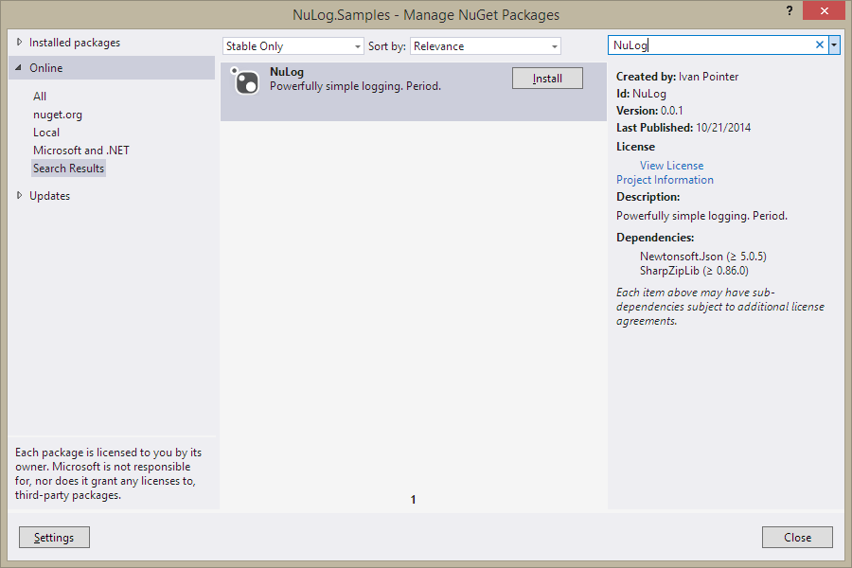
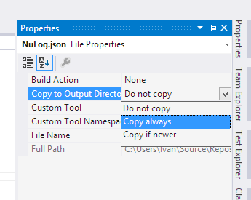
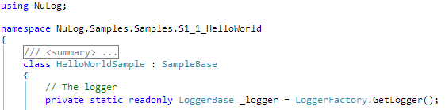
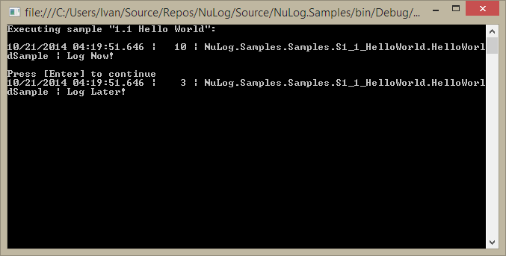

Project Setup
1
2
Install the NuLog package using NuGet
Mark the NuLog.json file for export, and edit it for your specific needs¹
“Use” the NuLog package, get an instance of the logger, then use it!
Enjoy the benefits of NuLog!
3
4
1. More on the details of configuration later in this presentation

Slide 20
Asynchronous Vs. Synchronous Logging
Vs.
Do three things well, not ten things badly

Slide 21
Asynchronous Vs. Synchronous Logging
Log events can be dispatched either now, or later
When to send a log event can be decided when the logger is called, in the configuration, or by the target¹
Vs.
1. Targets can pre-determine whether or not they are synchronous; for example, the console target defaults to send log events synchronously. This can be overridden in the configuration, assuming the target honors this configuration. Messages are still sent using a separate thread when using the asynchronous option of the logger however, but the log events maintain their order and are logged synchronously by the target.

Slide 22

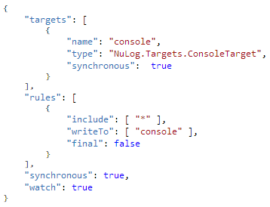
Concurrent Logging in the Logger
The base logger provides two types of log functions:
logger.Log will hint to the framework that this message can be sent asynchronously, unless the target configuration is set to send synchronously
logger.LogNow will hint to the framework that this message needs to be sent synchronously
If a log event is sent synchronously using “LogNow”, control will not be returned to the application until the log event has been dispatched to the targets
This behavior can be overridden at the target, or global configuration level

Slide 23
Concurrent Logging in the Target
A target can be set to synchronous logging using its configuration:
If “Log” is used, control is immediately returned to the calling application, but the log event is passed to the targets in another thread in a synchronous manner
A target can be set to synchronous in its implementation:
The architecture of the target and its configuration are designed such that a target can default to be synchronous. This is designed however, to be “overridden” in the configuration, either way.

Slide 24
Disabling Concurrent Logging
Concurrent logging can be disabled at a “global” level in the configuration:
If “synchronous” is set to true at the base configuration level, asynchronous logging will be completely turned off; all log events will be handled synchronously and no additional threads will be spun up to handle the logging; all logging will be performed on the thread that owns the framework.

Slide 25
Configuration
Everything should be as simple as it is, but not simpler

Slide 26
Configuration
File
JSON
NuLog can be configured using a JSON configuration file, or:
NuLog can be configured using a runtime configuration.
NuLog is designed to re-configure itself at runtime when the configuration changes¹
Runtime
1. NuLog uses the Observer Pattern to manage and announce configuration changes

Slide 27
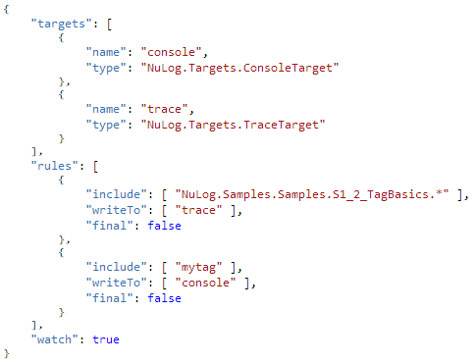
File Configuration
File
JSON
Configuration files are JSON files (*.json)¹
A single configuration file contains the configuration for all of the logging
Using configuration files allows NuLogging to monitor changes to the file, allowing for logging to be updated at runtime via the file
The rest of this presentation will use the JSON configuration format to sample the configuration structure
Runtime
1. The default name for the configuration file is ‘NuLog.json’ and is assumed to be in the “working directory” of the implementing application. If a file with a different name or location is used, it must be specified to the factory at runtime, or in the application config setting “NuLog.File”.

Slide 28
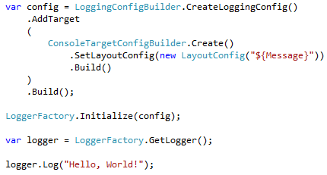
Runtime Configuration
File
JSON
Runtime configuration allows for other methods of configuring the logging via extension; such as using web or app config using a custom adapter
Helper classes called “Configuration Builders” are also provided to help with building the configuration at runtime¹
Runtime
1. The configuration builders use the Factory Method and Method Chaining patterns to help with building the configuration objects. If you create a custom target, you should provide “Configuration Builders” as well. A separate presentation will be provided about extending NuLog.

Slide 29
JSON Configuration
JSON
Everything should be as simple as it is, but not simpler

Slide 30
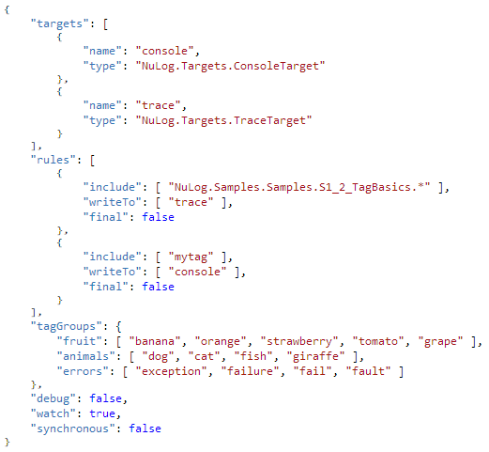
Configuration Anatomy
The logging configuration consists of 5 major pieces:
Targets
Rules
Tag Groups
Debug Flag
Watch Flag¹
Synchronous Flag
1. The watch flag is exclusive to the JSON file based configuration. More on this later in this presentation.

Slide 31
Targets
“targets” define the different targets that log messages can be dispatched to

Slide 32
Rules
“rules” define which log events are dispatched to which targets

Slide 33
Tag Groups
“tagGroups” define groups of tags which assist in defining rules¹
1. This is an advanced feature and will be covered in more detail later in this presentation

Slide 34
Debug
“debug” instructs the system to include the calling method information in every log message, instead of just ones with exceptions

Slide 35
Watch
“watch” tells the factory to watch the file for changes, allowing for runtime changes to configuration¹
1. The watch flag is exclusive to the JSON file based configuration. Note that if the developer sets “watch” to false at runtime, the file will no longer be watched by the system, and to turn file watching back on, the flag will need to be set to “true” and the implementing application restarted

Slide 36
Synchronous
“synchronous”, when set to true tells the framework to handle all log events synchronously; no additional threads will be spun up for logging; all logging will be performed on the thread that owns the logging framework instance

Slide 37
Runtime Configuration
Runtime
Everything should be as simple as it is, but not simpler

Slide 38
Runtime Configuration
The entire logging configuration is represented by a LoggingConfig instance
“Configuration Builders” leverage the “Factory Method” and “Method Chaining” patterns to simplify building configurations at runtime
The configuration keeps the same structure as the JSON configuration, allowing for the targets to be implemented agnostic to where configuration came from
The LoggerFactory allows initializing with a runtime built configuration object¹
1. This is the standard use of runtime configuration and the factory should be initialized before any logger instances are established

Slide 39
Runtime Configuration
The Factory uses the observer pattern for managing the configuration; the configuration can be updated and the factory re-initialized (Using LoggerFactory.Initialize), which will notify all of the dependent objects of the new configuration
When using runtime configuration, loggers need to be retrieved after the factory has been initialized with a configuration. They can thereafter be used as normal
The Factory caches instances of the logger in a singleton-like pattern, minimizing the overhead of getting a logger multiple times in a single instance¹
1. Unless a runtime Meta Data Provider instance is provided, at which point, a new instance of the logger is created. More on Meta Data Providers later in this presentation.

Slide 40
Runtime Configuration
Runtime configuration is used primarily for advanced implementations, such as extensions or wrappers¹
1. An organization could use these features to wrap the framework to fit the organization’s particular needs, while at the same time, minimizing complexity for their implementing developers

Slide 41
Standard Targets
Talent hits a target no one else can hit; Genius hits a target no one else can see

Slide 42

Basic Target (Abstract)
!
Abstract
All targets must extend the basic target
The basic target has a name, type and a synchronous flag:
The name identifies the target to the rules
The type is the full name of the class of the target¹
The synchronous flag is optional and defaults to false. If synchronous is set to true, log events are always sent directly to this target as opposed to being handled asynchronously²
1. Reflection is used to construct the target. When using custom targets in other assemblies, the assembly must be listed in the “type” property as well.
2. Assuming the target is built to honor this configuration. More on asynchronous vs. synchronous logging later in this presentation.

Slide 43
Layout Target (Abstract)
!
Abstract
${ }
The layout target defines a standard method for formatting the layout of text-based targets with a single layout format
The Layout Target is used for the standard text-based targets
Layouts are explored further, later in this presentation

Slide 44

Trace Target
Built from the Layout Target
The most basic of the standard targets
Writes to System.Diagnostics.Trace

Slide 45

Simple Console Target
Built from the Layout Target
Logs to the console using Console.Write¹
Simple, but high performance
1. Because Write is used (instead of WriteLine), the layout needs to include a newline character at the end if desired

Slide 46
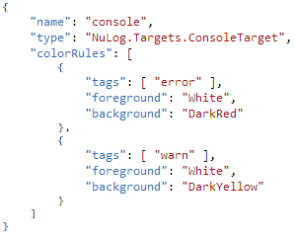
Console Target
Built from the Layout Target
Logs to the console using Console.Write¹
Administrators can define colors in the configuration which key off of tags. Colors are defined in System.ConsoleColor
Colors can be defined specifically for a log event by setting “ConsoleForeground” and “ConsoleBackground” in the log event’s meta data²
The performance of this is slower than the “Simple Console Target”, because this target handles coloring in the target
1. Because Write is used (instead of WriteLine), the layout needs to include a newline character at the end if desired
2. More on the meta data configuration later in this presentation

Slide 47
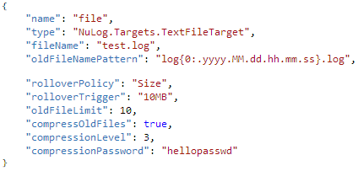

Text File Target
Built from the Layout Target
Logs to a specified text file
Highly configurable¹
Can rollover by size or daily
Can compress and password-protect old log files
1. All options specific to the text file target are shown here, there are many optional options here that are not required for configuration. See the detailed specifications for the targets for more information.

Slide 48
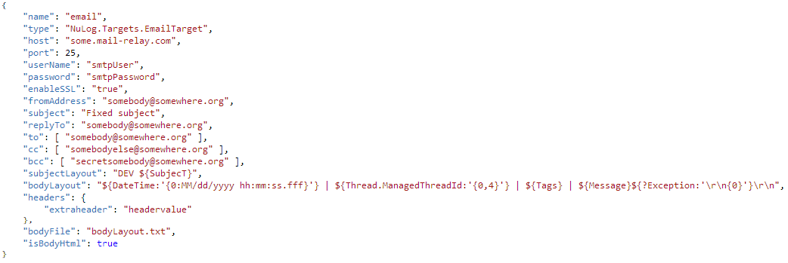
Email Target
Built from the Layout Target
Highly configurable¹
Handles authentication and SSL
Allows for adding “extra” headers to the email message
Allows for defining the body layout in a text file
Allows for sending attachments at runtime
1. All options specific to the email target are shown here, there are many optional options here that are not required for configuration. See the detailed specifications for the targets for more information.

Slide 49
Layouts
${?Layouts:’ | {0,4}’}
Style is a simple way of saying complicated things

Slide 50
Layouts
“My Property: ${?Property.Name:‘Formatted: {0}'}\r\n”
Layouts are a mechanism for converting a log event into text using a “layout” format
Layouts are used by the standard text-based targets (and the SMTP target)
Layouts allow for the formatting of different parts of the log event, even recursively
Layouts allow for conditionally showing formatted parts of the log event
“Hello: ${Message}”
“Hello Layout${?DateTime:': {0:MM/dd/yyyy hh:mm:ss.fff}'}!\r\n”

Slide 51
Static Text
“Hello Layout${?DateTime:': {0:MM/dd/yyyy hh:mm:ss.fff}'}!\r\n”
“Hello Layout: 10/13/2014 15:34:12.572!”
Anything not wrapped in a property enclosure ${} is treated as static text
Static text will always show in a log event formatted by a layout
Escaped characters are supported (and suggested!)

Slide 52
Parameter
“Hello Layout${?DateTime:': {0:MM/dd/yyyy hh:mm:ss.fff}'}!\r\n”
Conditional Flag
(Optional)
Parameters are wrapped with the property enclosure ${}
A single parameter in the layout format refers to a single property of the log event
Parameters have 3 parts:
Conditional Flag (Optional)
Property Name (Required)
Property Format (Optional)
Property Name
(Required)
Parameter Format
(Optional)

Slide 53
Conditional Flag
“Hello Layout${?DateTime:': {0:MM/dd/yyyy hh:mm:ss.fff}'}!\r\n”
Conditional Flag
(Optional)
The conditional flag is a single ‘?’ located at the front of the property, inside the enclosure ${}
If the conditional flag is present, the property will only be included in the resulting text if the property is not null or empty
Property Name
(Required)
Property Format
(Optional)

Slide 54
Property Name
“Hello Layout${?DateTime:': {0:MM/dd/yyyy hh:mm:ss.fff}'}!\r\n”
Conditional Flag
(Optional)
The name of the property within the log event is located at the beginning of the property string, after the conditional flag
All log events have optional “Meta Data”¹
The Property Name value is reflective and recursive, child values can be accessed with periods, for example: DateTime.Day
The “Meta Data” is searched first for the property (by name)
The log event is searched for the property (by name) if the property is not found in the “Meta Data”
Property Name
(Required)
Property Format
(Optional)
1. Meta Data is explored in more depth later in this presentation

Slide 55
Property Format
“Hello Layout${?DateTime:': {0:MM/dd/yyyy hh:mm:ss.fff}'}!\r\n”
Conditional Flag
(Optional)
The Property Format is used to format the value of the property which was evaluated from the log event
The Property Format is separated from the Property Name by a colon ‘:’
The Property Format is wrapped in single quotes to allow for escaping within the format string
The framework uses System.String.Format with the property format and value
Property Name
(Required)
Property Format
(Optional)

Slide 56
Example
“Hello Layout${?DateTime:': {0:MM/dd/yyyy hh:mm:ss.fff}'}!\r\n”
In the example on the left:
The DateTime value in the log event is used as the value for the property
Without a DateTime value in the log event, the “: “ in the string format would be excluded from the string because of the Conditional Flag
The DateTime is formatted using the format “: {0:MM/dd/yyyy hh:mm:ss.fff}”, as is specified in the layout format at the top
(Without DateTime Value)
“Hello Layout!”
(With DateTime Value)
“Hello Layout: 10/13/2014 15:34:12.572!”

Slide 57
Layout in the Standard Targets
Email
Subject
Body
Text File
Trace Target
Console Target
Text File Target
Email Target
Subject line
Body
Trace
Simple Console/
Console

Slide 58
Rules
The golden rule is that there are no golden rules

Slide 59
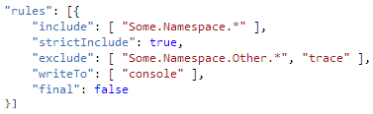
Rules
#OID.Agency.Application.Class
#dog
Rules define which targets log events are dispatched to based on their assigned tags
Rules are designed to work either independently, or in concert of each other
Rules are defined with 5 properties: “include”, “strictInclude”, “exclude”, “writeTo” and “final”
console

Slide 60
Rules: Include
#OID.Agency.Application.Class
#dog
“include” defines which tags to include in the rule
Wildcards “*” can be used to broaden the scope of a tag entry¹
If no tags are specified, all log events will be included in the rule
console
1. This is especially helpful for directing log events from a particular namespace or class to a target or set of targets

Slide 61
Rules: Strict Include
#OID.Agency.Application.Class
#dog
“strictInclude” identifies whether or not all tags identified by “include” must be matched by the log event for the log event to match the rule
A value of “true” indicates that all tags defined in “include” must have a matching tag in the log event for the log event to match the rule
console

Slide 62
Rules: Exclude
#OID.Agency.Application.Class
#dog
“exclude” identifies which tags will be explicitly excluded by the rule
Wildcards “*” can be used to broaden the scope of a tag entry¹
If left blank, it is assumed that none of the log events identified by “include” will be excluded
console
1. This is especially helpful for preventing log events from a particular namespace or class to a target or set of targets

Slide 63
Rules: Write To
#OID.Agency.Application.Class
#dog
“writeTo” identifies which targets (by name) matching log events will be dispatched to
console

Slide 64
Rules: Final
#OID.Agency.Application.Class
#dog
“final” specifies whether or not any other rules will be processed if this rule matches the log event
For example, if you have thee rules that match a given log event, and the second is marked as “final”, the third will not be processed for the log event
console

Slide 65
Tag Groups
A small group of thoughtful people could change the world. Indeed, it's the only thing that ever has.

Slide 66

Tag Groups
Tag groups allow for grouping multiple tags under a single tag
This is useful if you want a rule to apply for a “category” of tags, such as “fruit”, “animals” or “errors” (abstract example, but you can imagine how this could be helpful)¹
Observing the JSON to the left, the member name is the tag that represents the group, the child array being the tags that belong to the group
1. For example: the Legacy Logging extension uses Tag Groups to associate the different “trace” through “fatal” levels to each-other, allowing to emulate the legacy style of logging via levels

Slide 67
Tag Groups
#fish
#dog
For example:
Two log events, one tagged “fish” and one tagged “dog”
A single rule that states that “animals are to be dispatched to ‘console’”
Both “fish” and “dog” would be dispatched to the console
Dispatch #animals to “console”
console

Slide 68
Meta Data
Growth is never by mere chance; it is the result of forces working together

Slide 69
Meta Data
Log Event
Meta Data
Log events can have supplemental “Meta Data” which identifies additional information to be provided to the targets
Meta Data stays with the log event and is therefore available to the target
Meta Data is used in the standard targets, some examples include:
Foreground and background colors for the console target
Custom headers and subject for the SMTP target

Slide 70
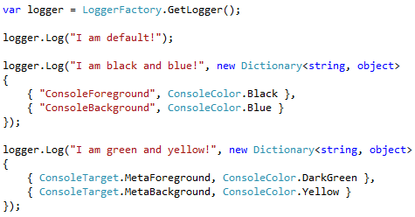

Meta Data
Meta Data is implemented as a set of name/value pairs¹
The Meta Data is attached to the log event, and therefore is available to the targets which handle the log event
The base logger provides methods for passing meta data in with the log call
1. IDictionary<string, object>

Slide 71
Meta Data
Well-behaved targets will:
Function regardless of the Meta Data’s presence or format
Treat passed-in Meta Data as an override to Meta Data established by Meta Data Providers¹
Povide constants for the names/keys of the Meta Data
1. More on Meta Data Providers later in this presentation

Slide 72
Console Target Meta Data
The Console Target supports Meta Data:
“ConsoleForeground” allows for overriding the foreground color of the console text
“ConsoleBackground” allows for overriding the background color of the console text
“ConsoleForeground”
“ConsoleBackground”

Slide 73
Email Target Meta Data
“EmailSubject”
The Email Target supports Meta Data:
“EmailSubject” overrides the subject
“EmailHeaders” includes additional headers
“EmailAttachments” attaches files to the email¹
“EmailTo” overrides who the mail is addressed to²
“EmailCC” overrides who is copied on the email²
“EmailBCC” overrides who is blind copied on the email²
“EmailHeaders”
“EmailAttachments”
“EmailTo”
“EmailCC”
1. A class “EmailAttachment” is provided which allows for defining a byte array, or a file name for attaching
2. A collection of string is expected for these
“EmailBCC”

Slide 74
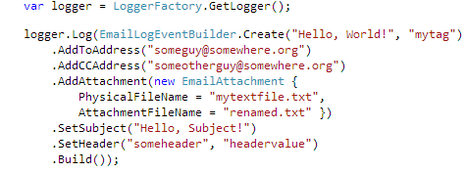
Email Target Logger Extensions
A helper class is provided that is called EmailLogEventBuilder, which provides for creating a custom log event with the meta data for an email, making sending “custom” emails in code simple¹
1. “using” NuLog.Extensions.Email

Slide 75
Meta Data Providers
If I went to work in a factory the first thing I'd do is join a union

Slide 76
Meta Data Providers
Meta Data Provider
Meta Data Providers supply meta data for log events
Meta Data Providers allow for an abstraction of meta data away from the line by line logging, minimizing boilerplate code
Meta Data Providers are useful for providing additional information to targets such as “Requestor IP” and “Session ID” without the developer having to pass this information with each call to the logger
Meta Data Providers can be loaded automatically, or manually at runtime¹
Logging Application
1. Meta Data Providers are loaded using the MEF framework in code; or at runtime when requesting the logger from the factory (such as is useful for MVC Controllers)

Slide 77
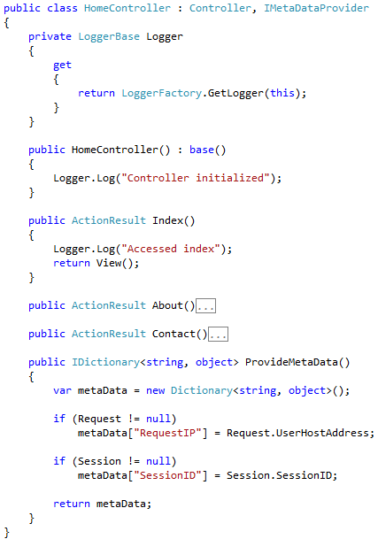
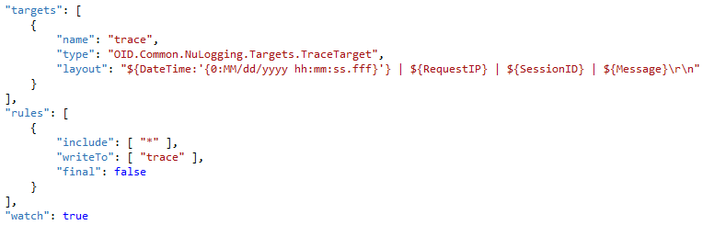
Runtime Meta Data Provider
Home Controller:
1
3
A practical example of using a runtime Meta Data provider:
The Meta Data provider (the controller itself) is passed into the LoggerFactory when retrieving the logger
The Request IP and Session ID are automatically captured by the controller
The calls to the logger don’t have to have to pass the Request IP or the Session ID now
Using a layout target (TraceTarget), the Request IP and Session IP are made available
All of this is done using the standard components built into the framework, no additional extensions were included or written to achieve this
2
JSON Config:
4
Trace Target:

Slide 78
Runtime Meta Data Provider
Home Controller:
The highlighted sections are simply and easily abstracted out to another class and reused¹:
An abstract class, named perhaps LoggingControllerBase that implements/extends Controller and IMetaDataProvider
Change the scope of the Logger property to protected or higher
The concrete controllers would then extend LoggingControllerBase, inheriting access to the Logger and the populated Meta Data for free!
JSON Config:
Trace Target:
1. This will be done in the simple wrapper, or in the application template

Slide 79
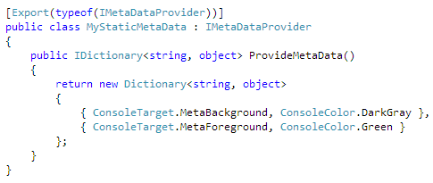
Static Meta Data Provider
Static meta data providers are useful for providing meta data at a global level; information that is not request specific, such as machine name, environment or even console color¹
MEF is used to automatically wire up static meta data providers, no extra wiring (after the “Export” attribute) is required by the implementing developer
1. Practically, this will be helpful for providing information to a DB logger; information like machine name, environment logged-by etc.

Slide 80
Performance Tests
An ounce of performance is worth pounds of promises

Slide 81
Standard Performance
(Milliseconds Per Message Logged)
When comparing the default asynchronous performance of NuLog to the other major frameworks:
NuLog is much faster at handling log events and returning control back to the logging application than the other two
NuLog beats Log4Net and NLog in the console by over 6/100 milliseconds per log event
NuLog beats Log4Net by over 9/1000 milliseconds per log event, and NLog by a whopping 22/100 milliseconds per log event

Slide 82
Customization and Extension
Like all magnificent things, it's very simple

Slide 83
Customization and Extension
NuLog is designed from the ground up with extension and customization in mind, and is therefore, very highly customizable and extensible
The high performance of the framework is inherited by custom targets that are written¹
Another presentation will be provided which details creating a custom target for the framework which explores much more the details of extending the framework
1. Careful consideration still needs to be made in terms of synchronization when writing custom targets.

Slide 84
Licensing and Credits
It is amazing what you can accomplish if you do not care who gets the credit

Slide 85
NuLog Licensing
NuLog is released under the MIT license (http://opensource.org/licenses/MIT) with the understanding that this software depends on other open source libraries that have their own, independent licensing:
Json.NET
MIT License
http://json.codeplex.com/license
SharpZipLib
Modified GPL License (Allowing “terms of [our] choice”)
http://icsharpcode.github.io/SharpZipLib/
The original author of this library (Ivan Andrew Pointer of Salem Oregon) reserves the right to change this license at any time for any future release of the software and retain full ownership of the software and source code. Any copies you have obtained before any license change will still be governed the license they were released under.
It is not my intent to ever stop providing this library as a free (as in free beer) solution. I may provide enterprise support in the future.

Slide 86
Quotes Attribution
It is amazing what you can accomplish if you do not care who gets the credit
Harry S. Truman
Like all magnificent things, it's very simple
Natalie Babbitt, Tuck Everlasting
Simplicity is the ultimate sophistication
Leonardo da Vinci
Coming together is a beginning; keeping together is progress; working together is success
Henry Ford
Talent hits a target no one else can hit; Genius hits a target no one else can see
Arthur Schopenhauer
The quotes shown in this presentation are attributed to the left
Everything should be as simple as it is, but not simpler
Albert Einstein
Do three things well, not ten things badly
David Segrove
Style is a simple way of saying complicated things
Jean Cocteau
The golden rule is that there are no golden rules
George Bernard Shaw
A small group of thoughtful people could change the world. Indeed, it's the only thing that ever has.
Margaret Mead
Growth is never by mere chance; it is the result of forces working together
James Cash Penney
If I went to work in a factory the first thing I'd do is join a union
Franklin D. Roosevelt
An ounce of performance is worth pounds of promises
Mae West

